Slide 1
Clarifications
Homework assignments -> required, but not graded
Project Team -> we will finalize the teams tonight.
DB Topic/Project proposal -> due before next class
  Problem statement
  Objectives

Slide 2
Project Deliverables
P1. Team Formation, DB Topic and Objectives 5%
P2. Database Design, Initial ERD 10%
P3. Final ERD 5%
P4. Database Implementation 10%
P5. Presentation 10%

Slide 3
Grading - overall
Assessment % Grade
2 Quizzes 30%
3 Labs 20%
Database project 40%
Participation 10%

Slide 4
Labs
3 in class labs
  Based on topics we are covering
  They have not been scheduled yet, there is no due dates.
  Worth 20% of your final grade

Slide 5
Chapter 1 Review:
The Database Environment

Slide 6
Objectives
Basic Definition of terms
Name limitations of conventional file processing
Explain advantages of databases

Slide 7
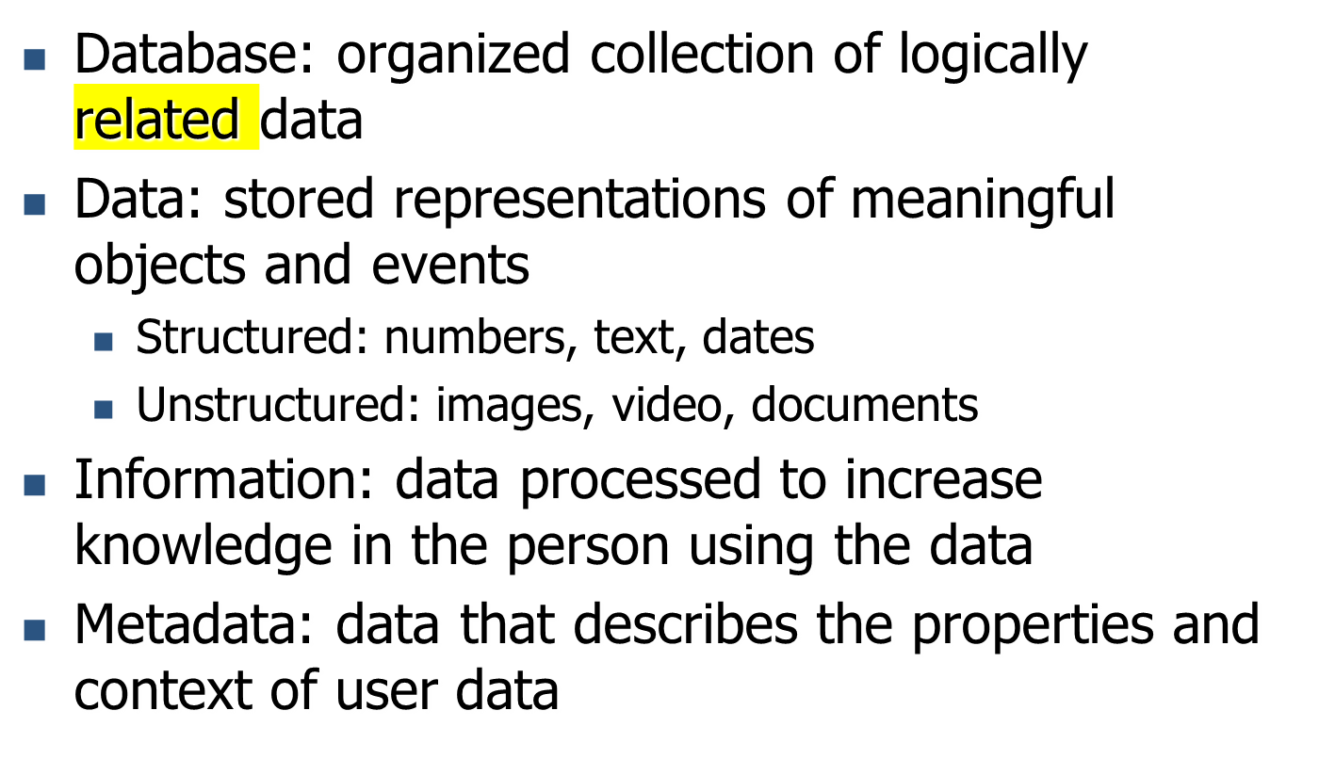
Definitions
Notes:
Database – keyword is related
Data, and the difference between data and information
Metadata

Slide 8
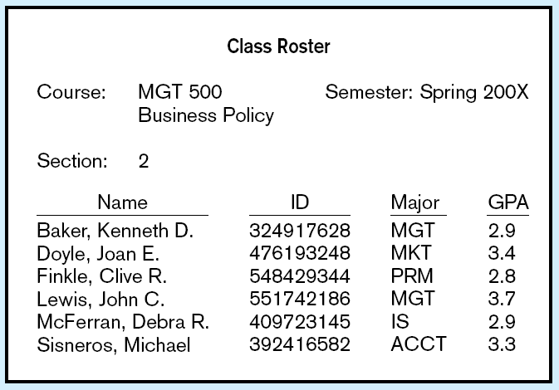
Figure 1-1a Data in context
Context helps users understand data
Notes:
Example of data presented in a useful manner, which makes it information
Example of ID, without context, still a piece of data, but no meaningful to consumers of it

Slide 9
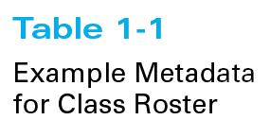
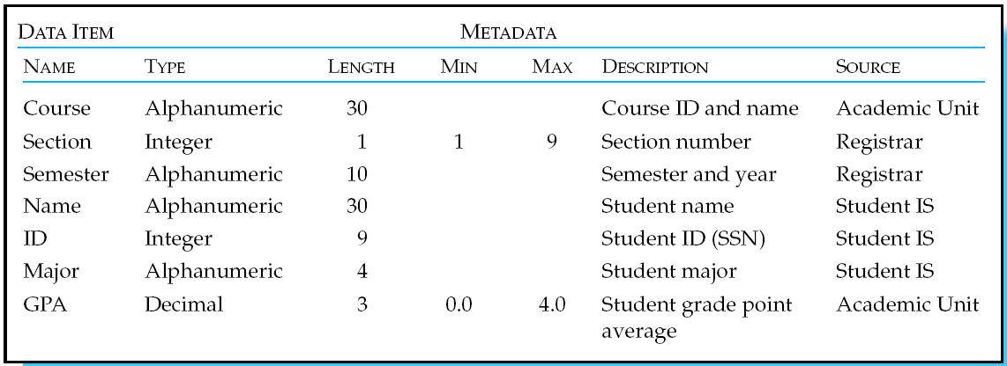
Descriptions of the properties or characteristics of the data, including data types, field sizes, allowable values, and data context
Notes:
Meta Data

Slide 10
Disadvantages of File Processing
Program-Data Dependence
  All programs maintain metadata for each file they use
Duplication of Data
  Different systems/programs have separate copies of the same data
Limited Data Sharing
  No centralized control of data
Lengthy Development Times
  Programmers must design their own file formats
Excessive Program Maintenance
  80% of information systems budget
Notes:
Earlier systems used file processing: prior to 1980

Slide 11
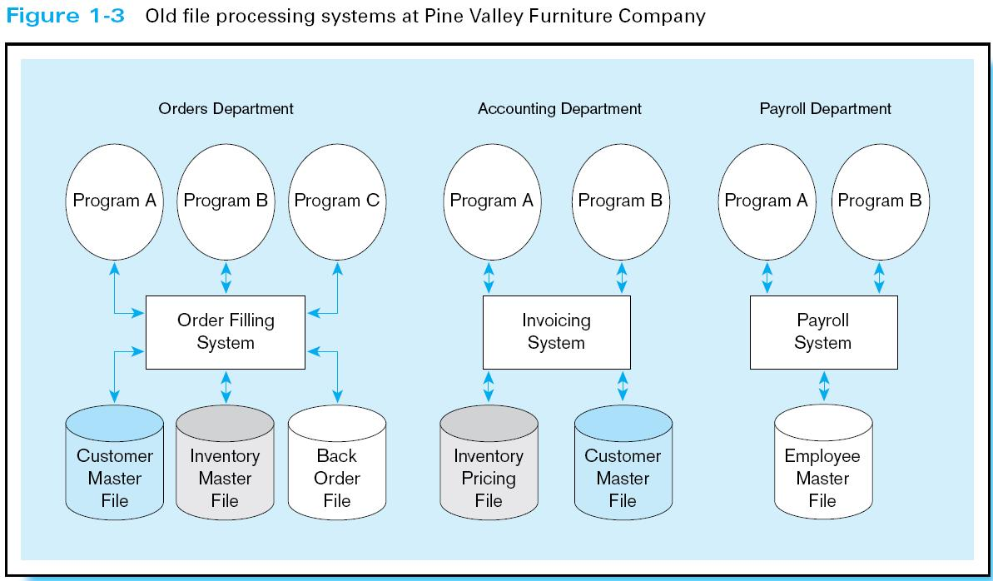
Duplicate Data
Notes:
Example of Pine Valley Legacy system
Main issue was data duplication

Slide 12
Problems with Data Redundancy
Waste of space to have duplicate data
Causes more maintenance headaches
The biggest problem:
  Data changes in one file could cause inconsistencies
  Compromises in data integrity

Slide 13
SOLUTION:
The DATABASE Approach
Central repository of shared data
Data is managed by a controlling agent
Stored in a standardized, convenient form
Requires a Database Management System (DBMS)

Slide 14
Database Management System
A software system that is used to create, maintain, and provide controlled access to user databases
Order Filing
System
Central database
Contains employee,
order, inventory,
pricing, and
customer data
Invoicing
System
DBMS
Payroll
System
DBMS manages data resources like an operating system manages hardware resources

Slide 15
Advantages of the Database Approach
Program-data independence
Planned data redundancy
Improved data consistency
Improved data sharing
Increased application development productivity
Enforcement of standards
Improved data quality
Improved data accessibility and responsiveness
Reduced program maintenance
Improved decision support

Slide 16
Elements of the Database Approach
Data models
  Graphical system capturing nature and relationship of data
  Enterprise Data Model–high-level entities and relationships for the organization
  Project Data Model–more detailed view, matching data structure in database or data warehouse
Relational Databases
  Database technology involving tables (relations) representing entities and primary/foreign keys representing relationships
Use of Internet Technology
  Networks and telecommunications, distributed databases, client-server, and 3-tier architectures
Database Applications
  Application programs used to perform database activities (create, read, update, and delete) for database users

Slide 17
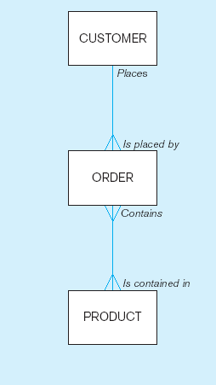
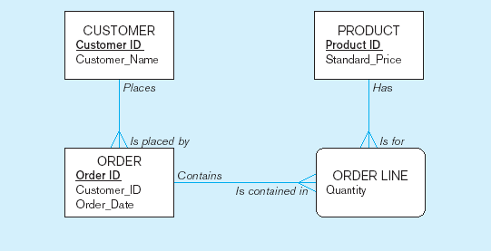
Figure 1-2 Comparison of enterprise and project level data models
Segment of an enterprise data model
Segment of a project-level data model

Slide 18
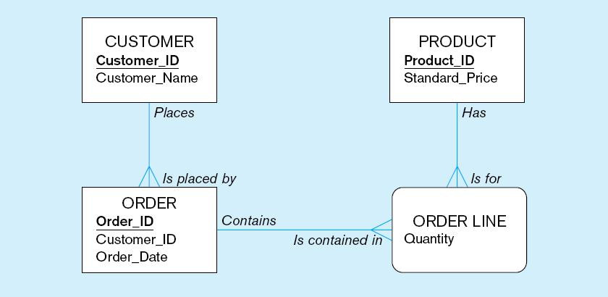
One customer may place many orders, but each order is placed by a single customer
→ One-to-many relationship

Slide 19
One order has many order lines; each order line is associated with a single order
→ One-to-many relationship

Slide 20
One product can be in many order lines, each order line refers to a single product
→ One-to-many relationship

Slide 21
Therefore, one order involves many products and one product is involved in many orders
→ Many-to-many relationship

Slide 22
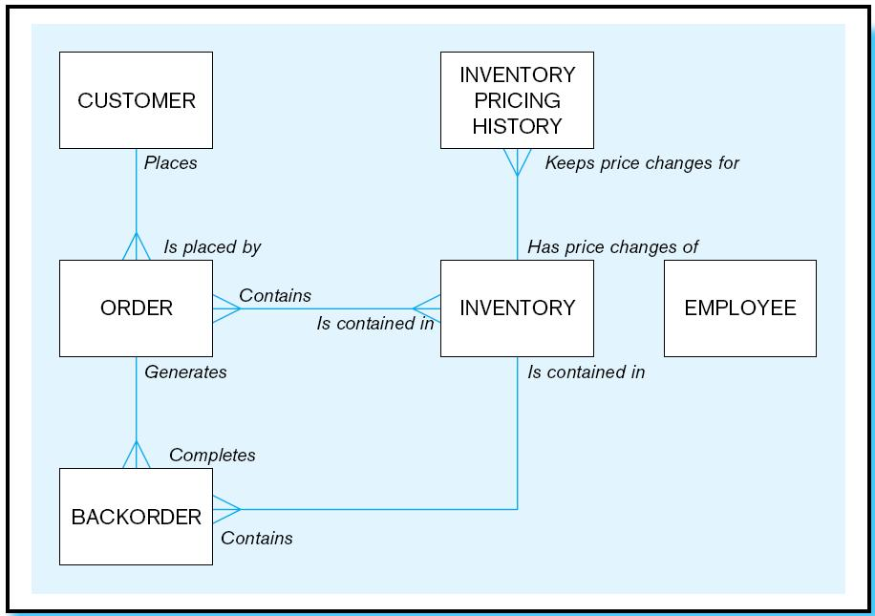
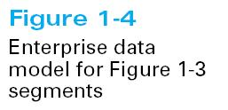

Slide 23
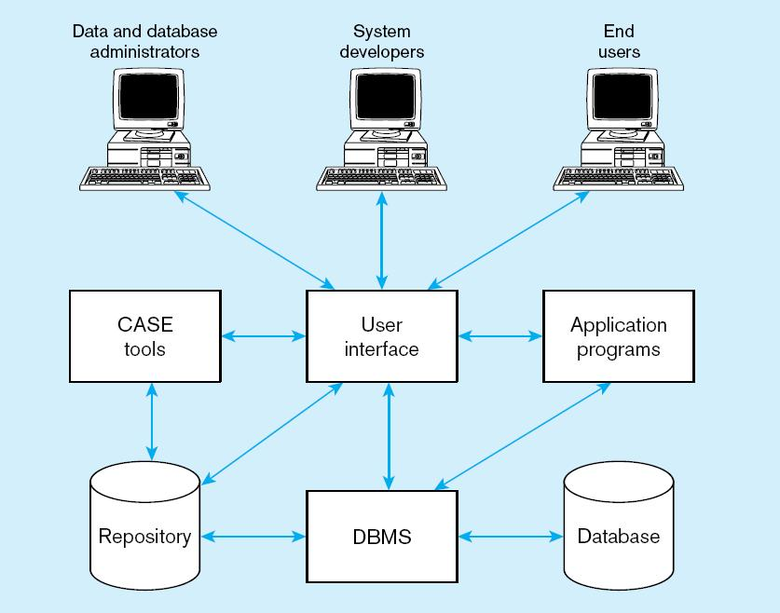
Figure 1-5 Components of the Database Environment
Notes:
DB – data
Repository - metadata

Slide 24
Components of the
Database Environment
CASE Tools–computer-aided software engineering
Repository–centralized storehouse of metadata
Database Management System (DBMS) –software for managing the database
Database–storehouse of the data
Application Programs–software using the data
User Interface–text and graphical displays to users
Data/Database Administrators–personnel responsible for maintaining the database
System Developers–personnel responsible for designing databases and software
End Users–people who use the applications and databases

Slide 25
The Range of Database Applications
Personal databases
Workgroup databases
Departmental/divisional databases
Enterprise database
  Enterprise resource planning (ERP) systems
  Data warehousing implementations

Slide 26
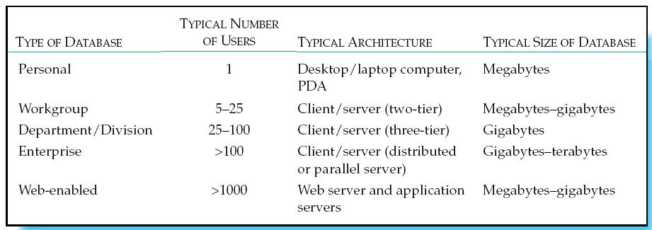
Table 1-6 Summary of Database Applications

Slide 27
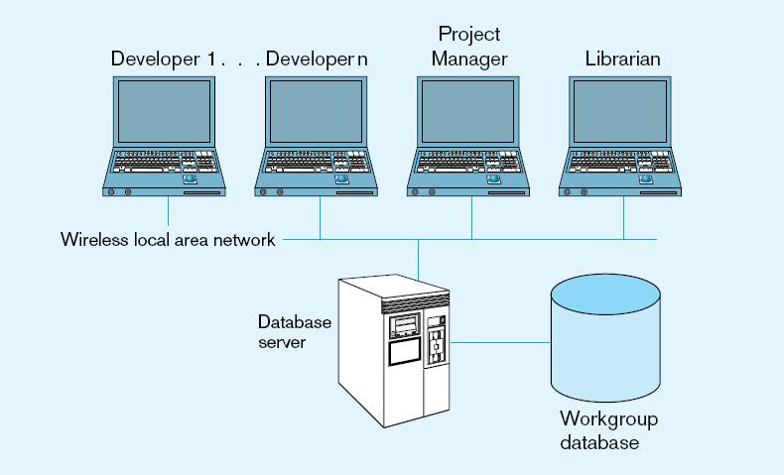
Figure 1-7 Workgroup database with wireless
local area network

Slide 28
Enterprise Database Applications
Enterprise Resource Planning (ERP)
  Integrate all enterprise functions (manufacturing, finance, sales, marketing, inventory, accounting, human resources)
Data Warehouse
  Integrated decision support system derived from various operational databases

